Slide 1
Uplistsikhe
Complex Environmental Monitoring

Slide 2
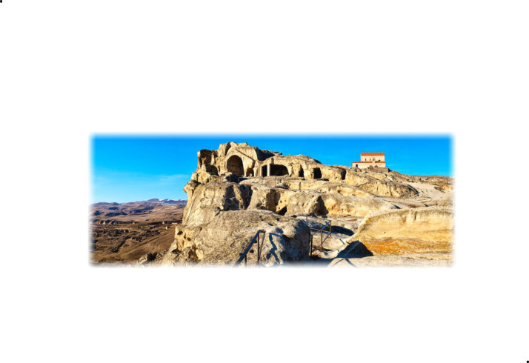
Uplistsikhe
"the lord's fortress"
Rock-hewn town in Georgia

Slide 3
Complex Study, Monitoring and Conservation

Slide 4
Concept of Complex Study, Monitoring and Conservation

Slide 5
Concept of Complex Study, Monitoring and Conservation

Slide 6
Concept of Complex Study, Monitoring and Conservation

Slide 7
Concept of Complex Study, Monitoring and Conservation

Slide 8
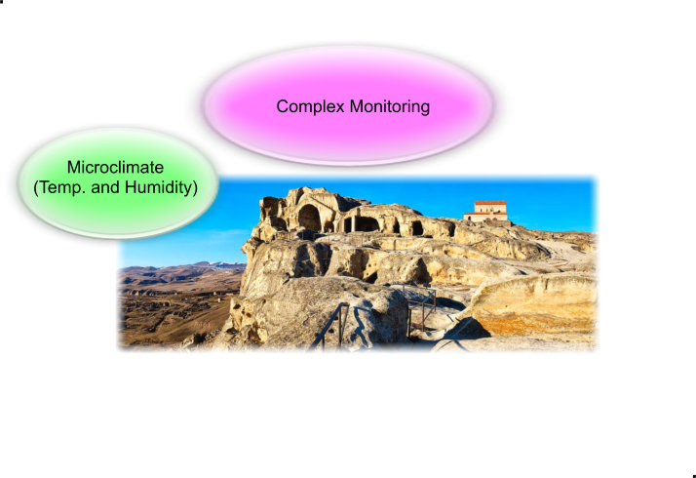
Concept of Complex Study, Monitoring and Conservation

Slide 9
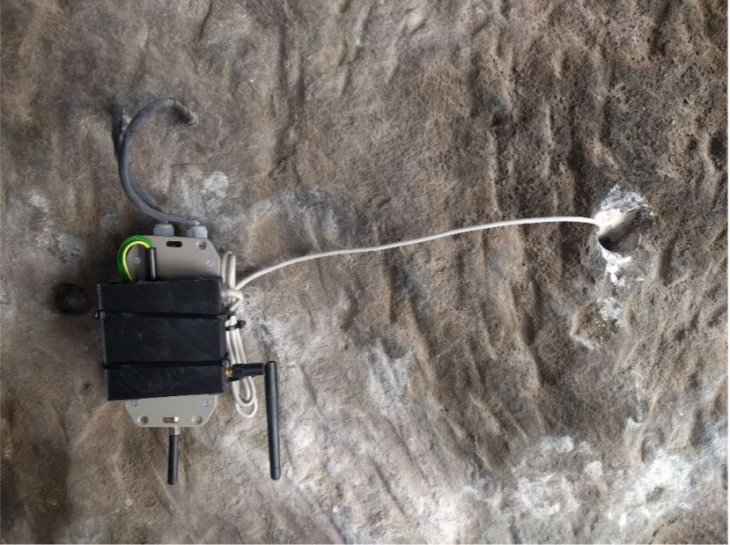
Concept of Complex Study, Monitoring and Conservation

Slide 10
Concept of Complex Study, Monitoring and Conservation

Slide 11
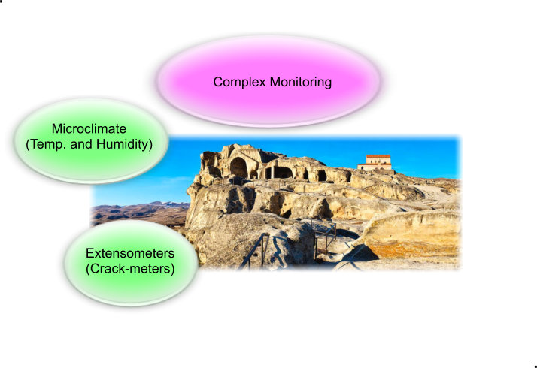
Concept of Complex Study, Monitoring and Conservation

Slide 12
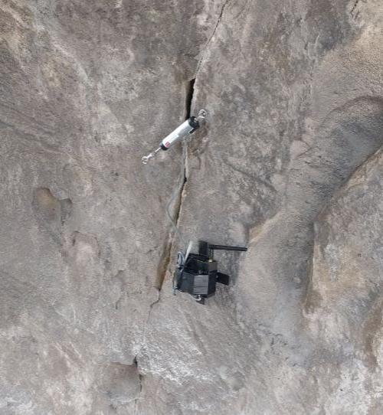
Concept of Complex Study, Monitoring and Conservation

Slide 13
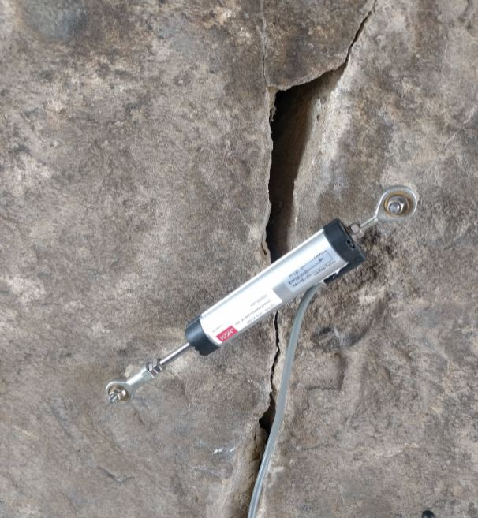
Concept of Complex Study, Monitoring and Conservation

Slide 14
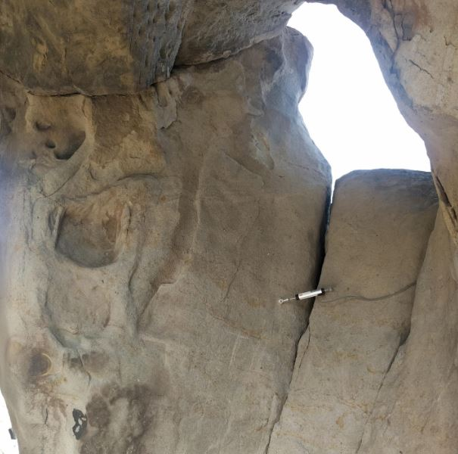
Concept of Complex Study, Monitoring and Conservation

Slide 15
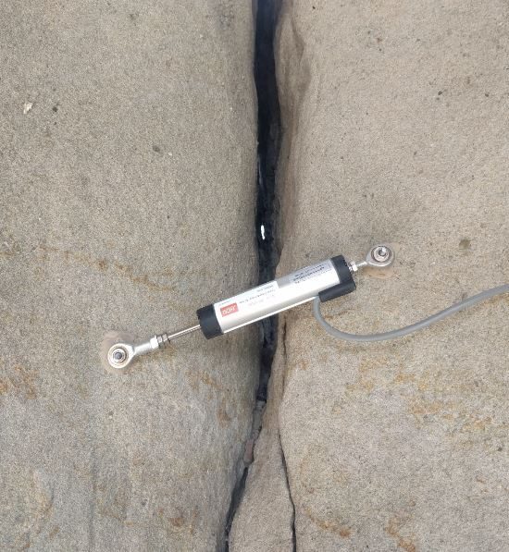
Concept of Complex Study, Monitoring and Conservation

Slide 16
Concept of Complex Study, Monitoring and Conservation

Slide 17
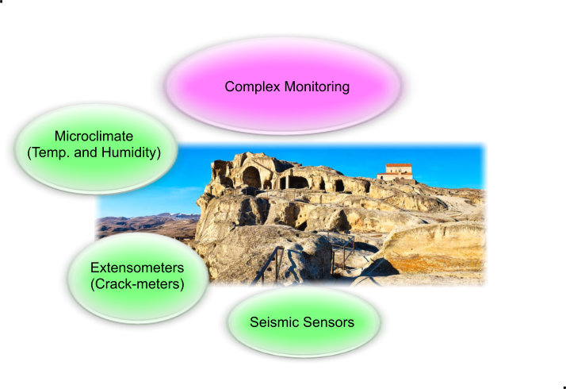
Concept of Complex Study, Monitoring and Conservation

Slide 18
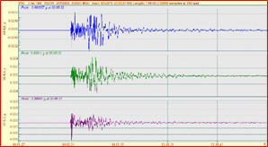
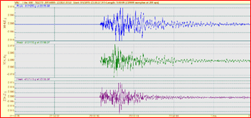
Concept of Complex Study, Monitoring and Conservation

Slide 19
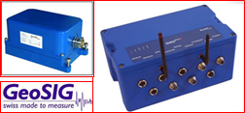
Concept of Complex Study, Monitoring and Conservation

Slide 20
Concept of Complex Study, Monitoring and Conservation

Slide 21
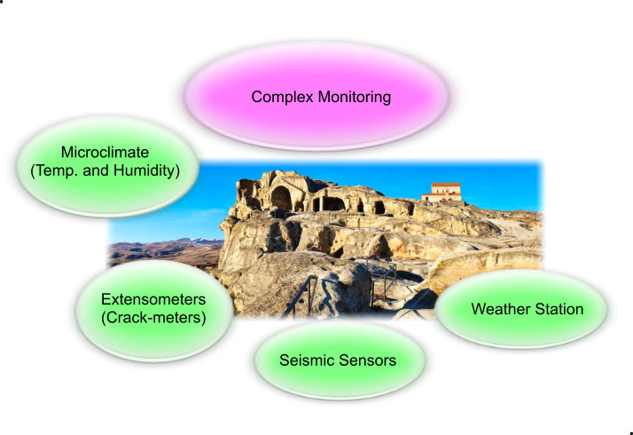
Concept of Complex Study, Monitoring and Conservation

Slide 22
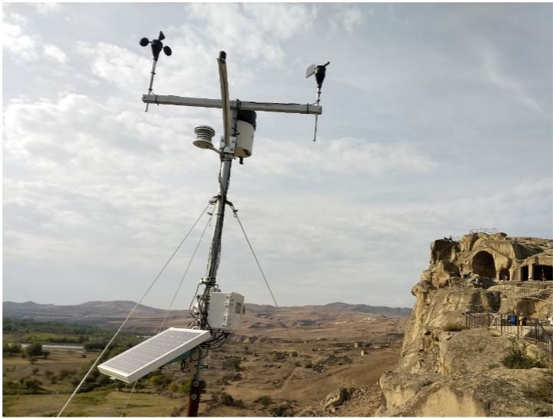
Concept of Complex Study, Monitoring and Conservation

Slide 23
Concept of Complex Study, Monitoring and Conservation

Slide 24
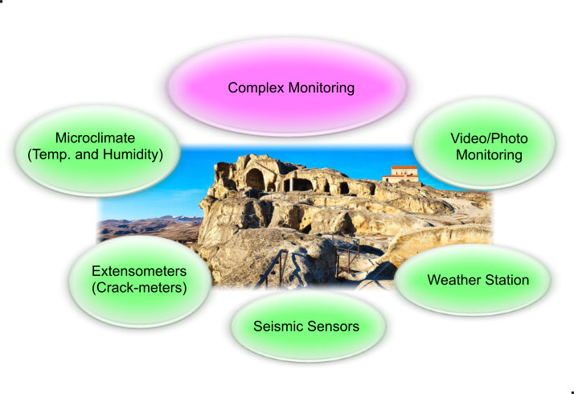
Concept of Complex Study, Monitoring and Conservation

Slide 25
Concept of Complex Study, Monitoring and Conservation

Slide 26
Concept of Complex Study, Monitoring and Conservation

Slide 27
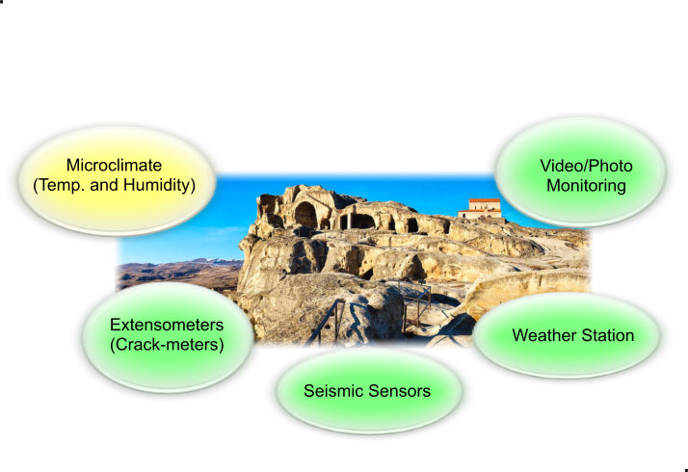
MAXIOT system hardware sensor components

Slide 28
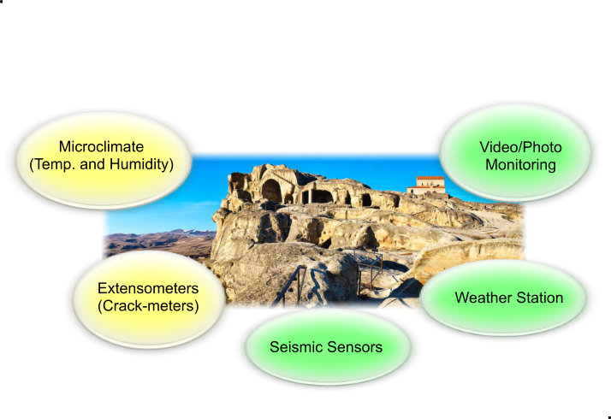
MAXIOT system hardware sensor components

Slide 29
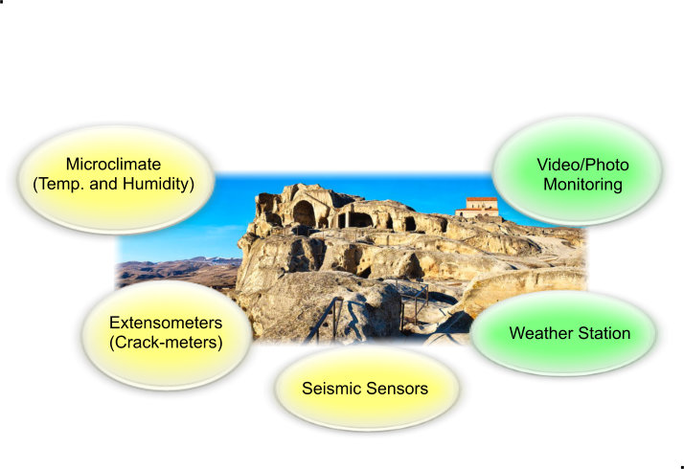
MAXIOT system hardware sensor components

Slide 30
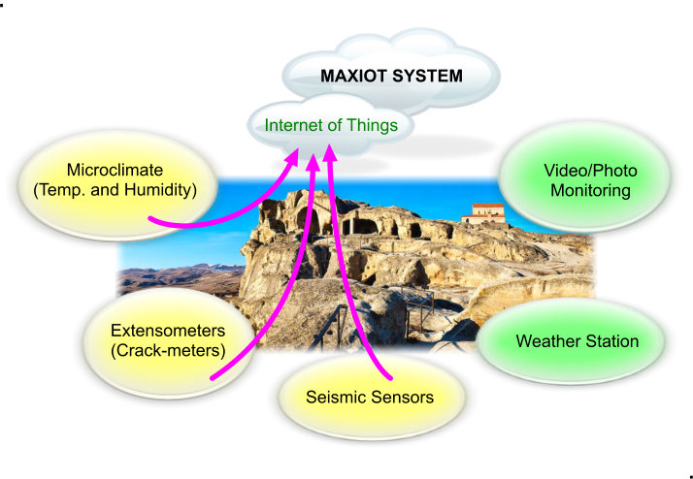
MAXIOT system hardware sensor components

Slide 31
MAXIOT SYSTEM ( The Internet of Things )

Slide 32
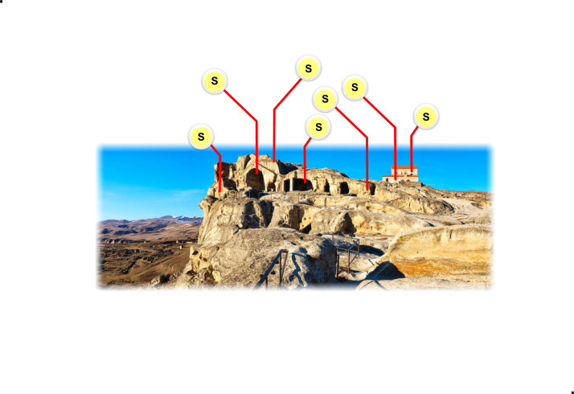
MAXIOT SYSTEM ( The Internet of Things )

Slide 33
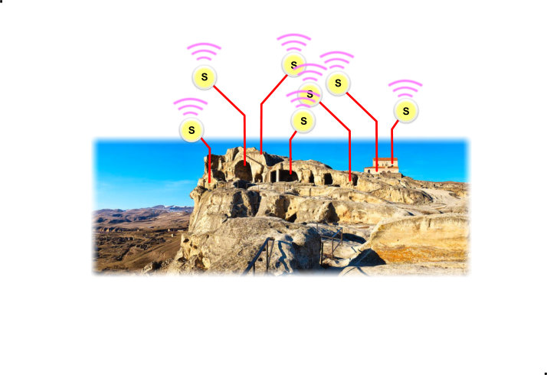
MAXIOT SYSTEM ( The Internet of Things )

Slide 34
MAXIOT SYSTEM ( The Internet of Things )

Slide 35
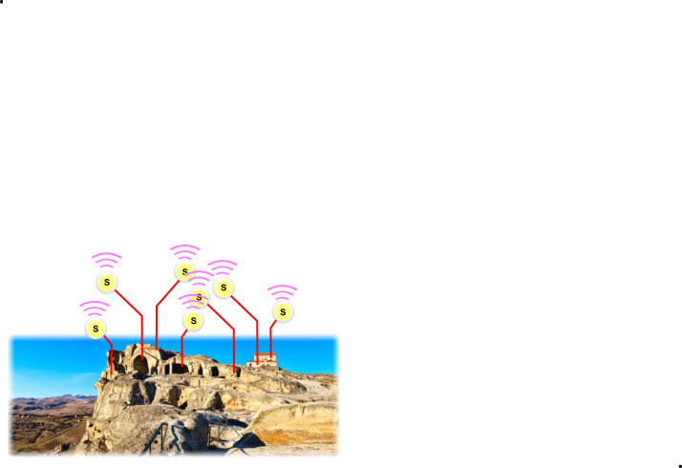
MAXIOT SYSTEM ( The Internet of Things )

Slide 36
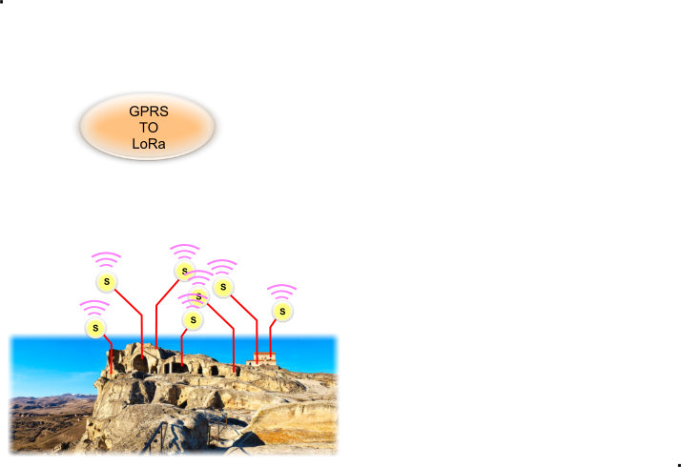
MAXIOT SYSTEM ( The Internet of Things )

Slide 37
MAXIOT SYSTEM ( The Internet of Things )

Slide 38
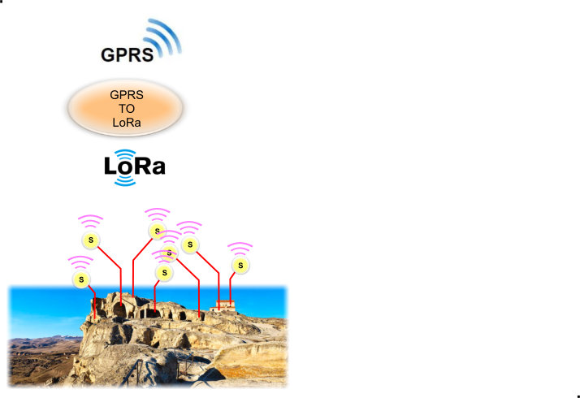
MAXIOT SYSTEM ( The Internet of Things )

Slide 39
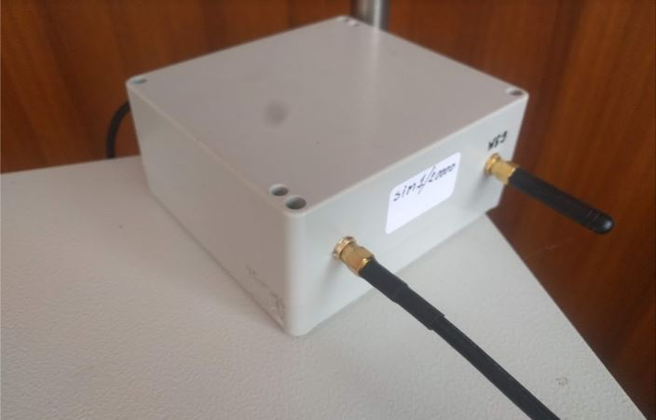
MAXIOT SYSTEM ( The Internet of Things )

Slide 40
MAXIOT SYSTEM ( The Internet of Things )

Slide 41
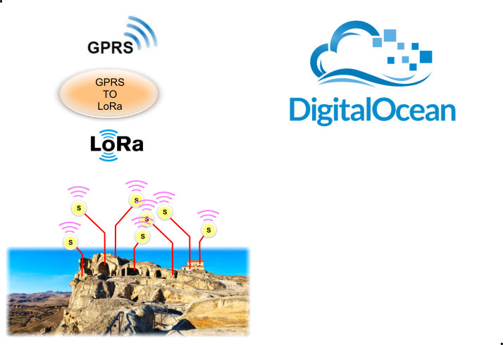
MAXIOT SYSTEM ( The Internet of Things )

Slide 42
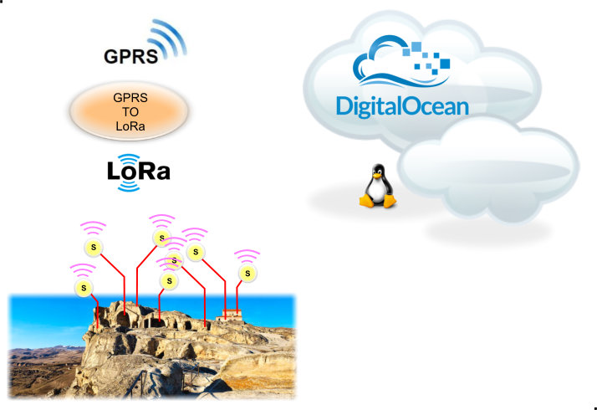
MAXIOT SYSTEM ( The Internet of Things )

Slide 43
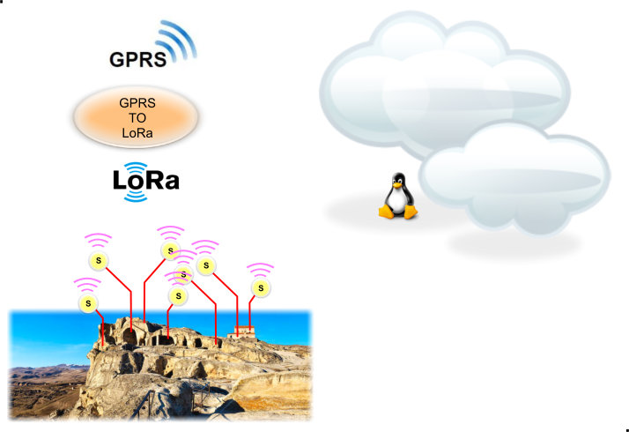
MAXIOT SYSTEM ( The Internet of Things )

Slide 44
MAXIOT SYSTEM ( The Internet of Things )

Slide 45
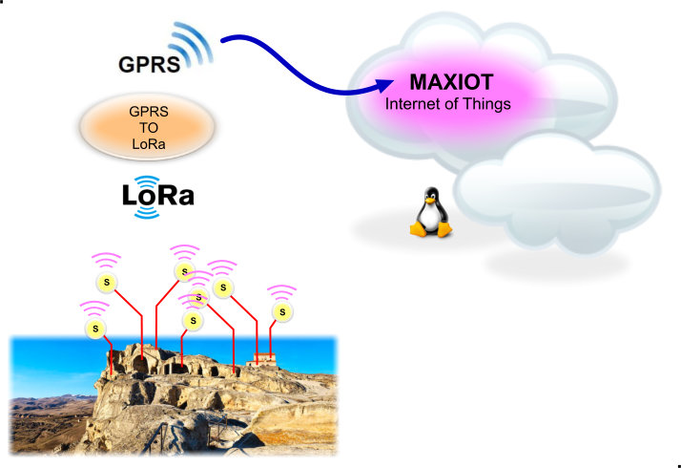
MAXIOT SYSTEM ( The Internet of Things )

Slide 46
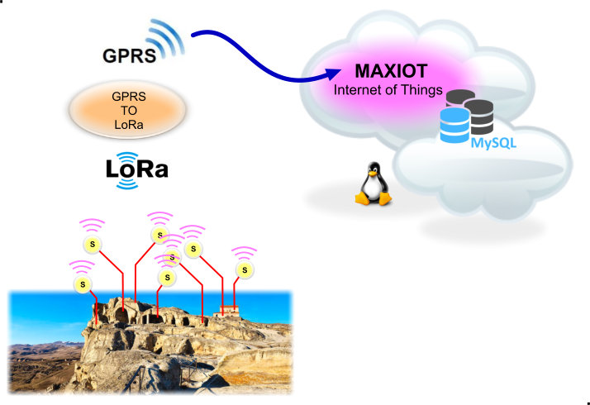
MAXIOT SYSTEM ( The Internet of Things )

Slide 47
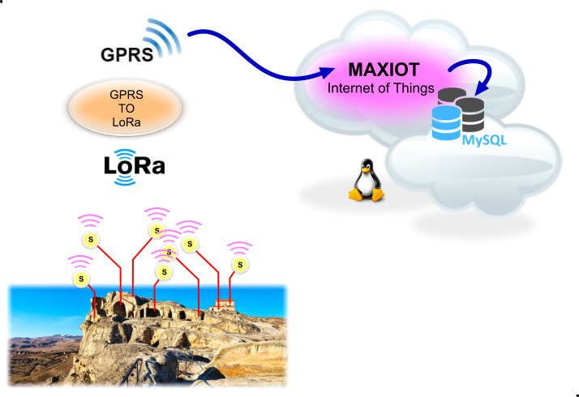
MAXIOT SYSTEM ( The Internet of Things )

Slide 48
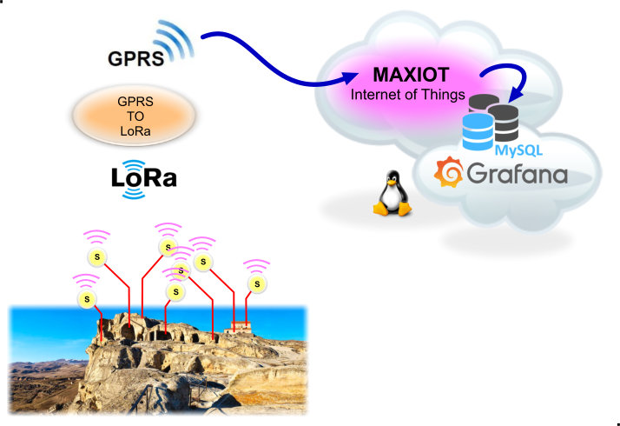
MAXIOT SYSTEM ( The Internet of Things )

Slide 49
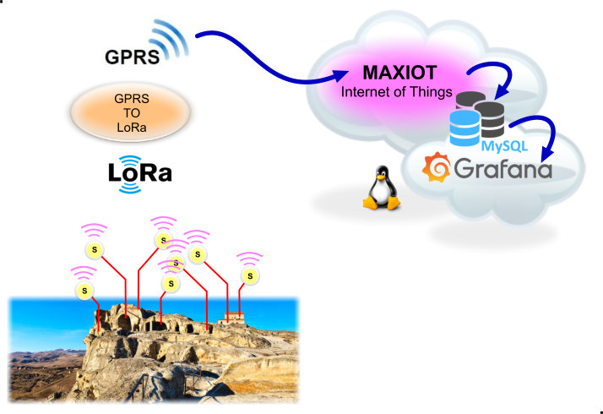
MAXIOT SYSTEM ( The Internet of Things )

Slide 50
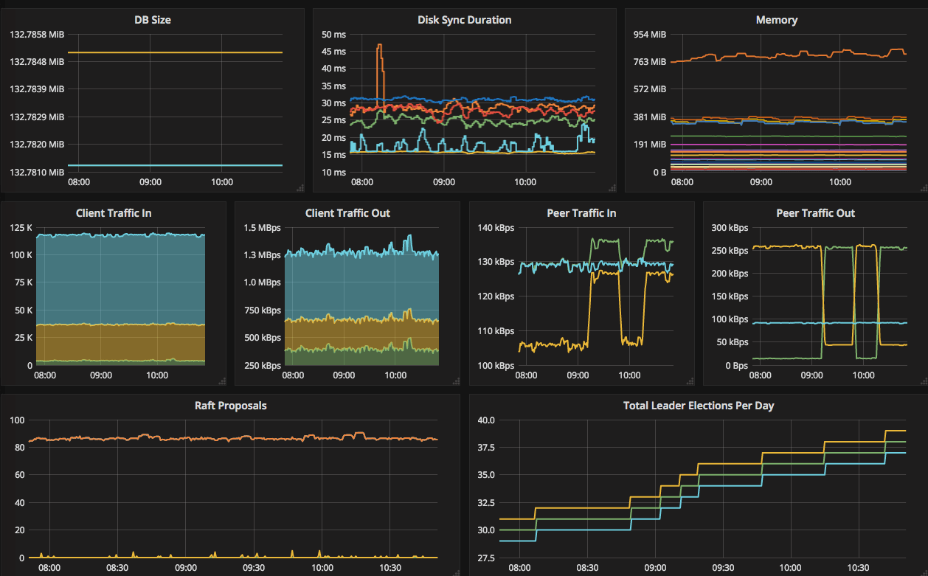
MAXIOT SYSTEM ( The Internet of Things )

Slide 51
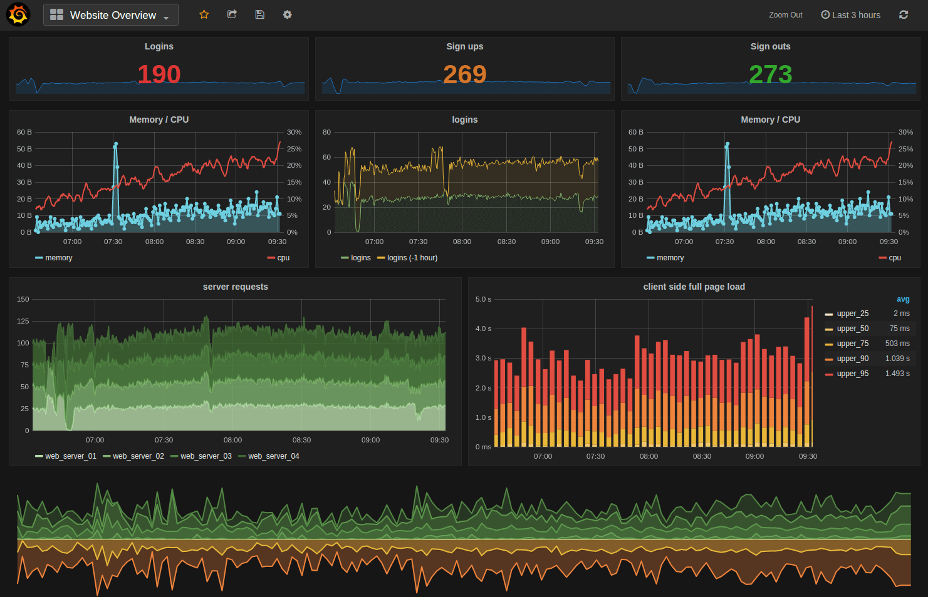
MAXIOT SYSTEM ( The Internet of Things )

Slide 52
MAXIOT SYSTEM ( The Internet of Things )

Slide 53
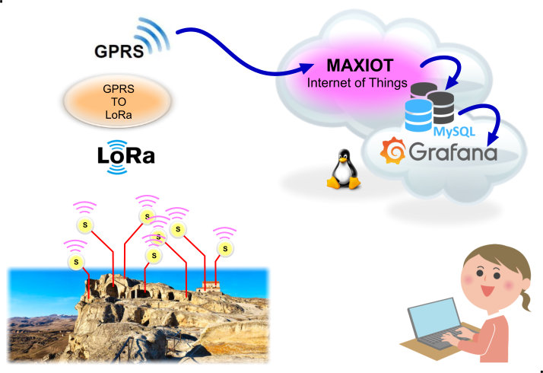
MAXIOT SYSTEM ( The Internet of Things )

Slide 54
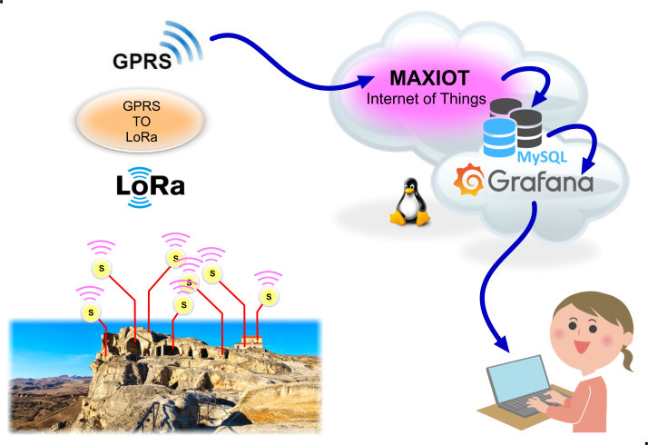
MAXIOT SYSTEM ( The Internet of Things )

Slide 55
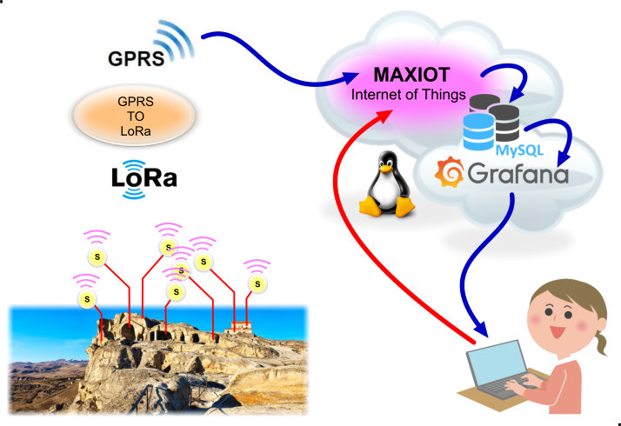
MAXIOT SYSTEM ( The Internet of Things )

Slide 56
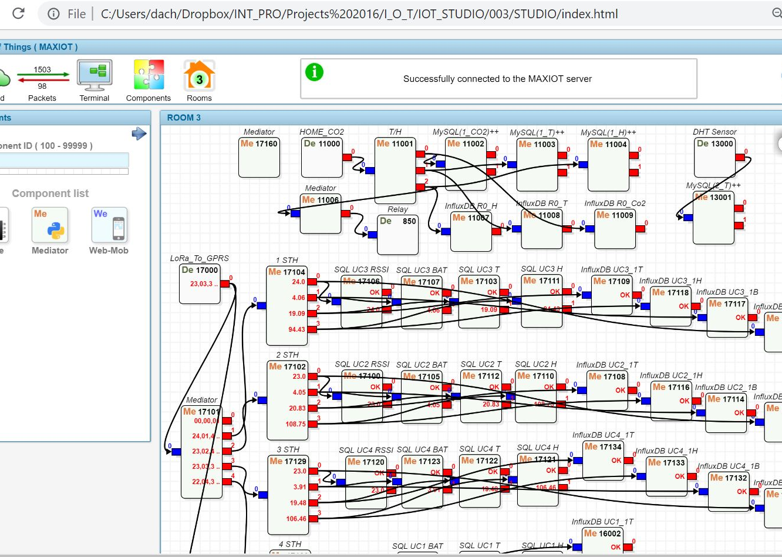
MAXIOT SYSTEM ( The Internet of Things )

Slide 57
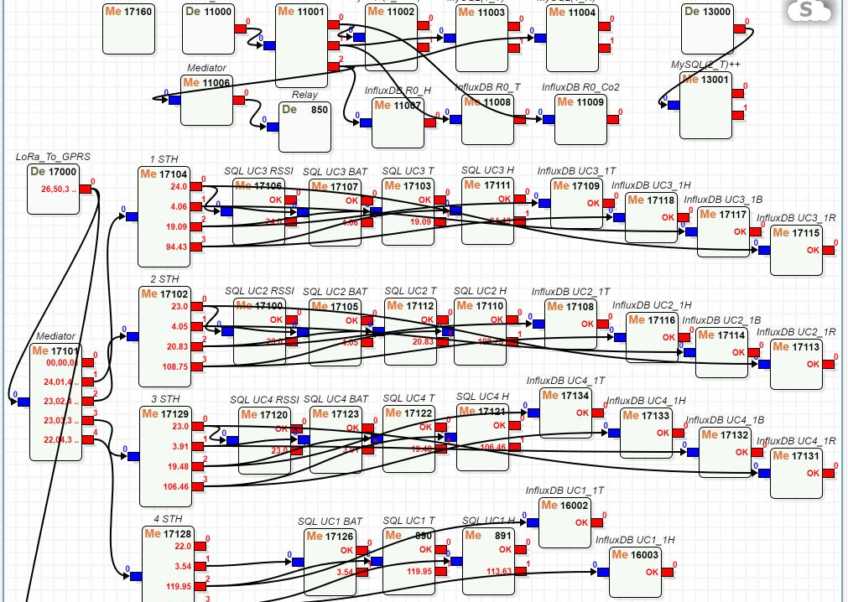
MAXIOT SYSTEM ( The Internet of Things )

Slide 58
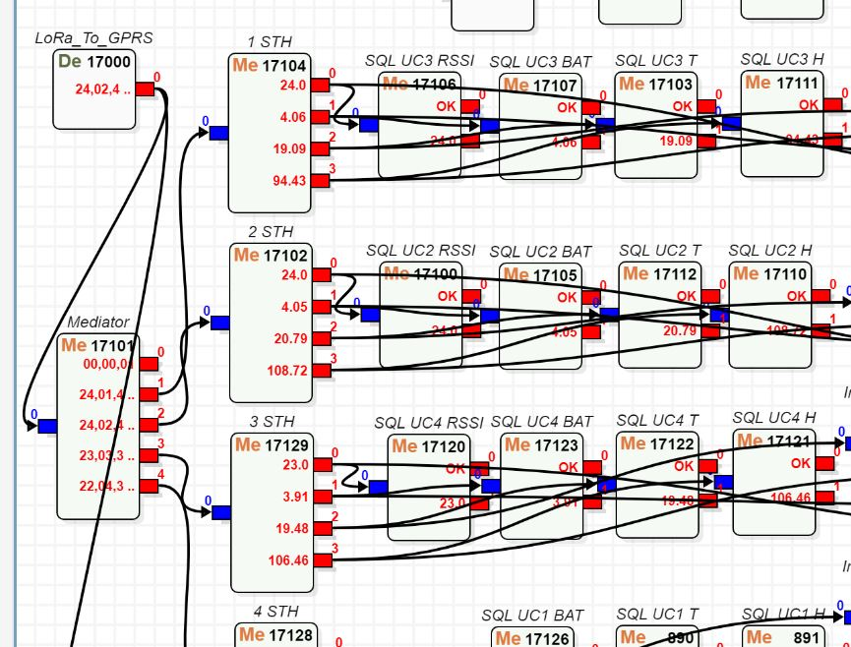
MAXIOT SYSTEM ( The Internet of Things )

Slide 59
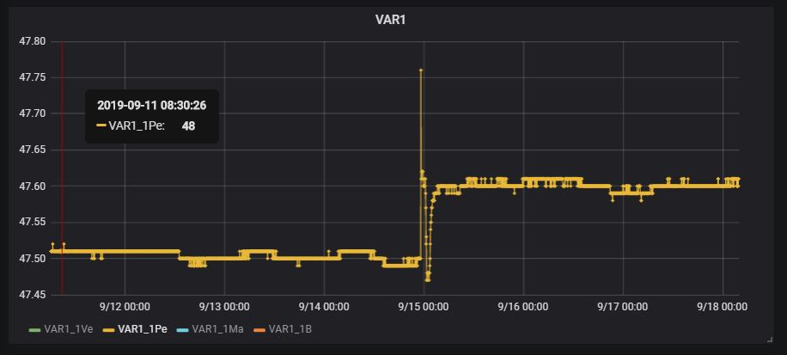
MAXIOT SYSTEM ( The Internet of Things )

